Slide 1
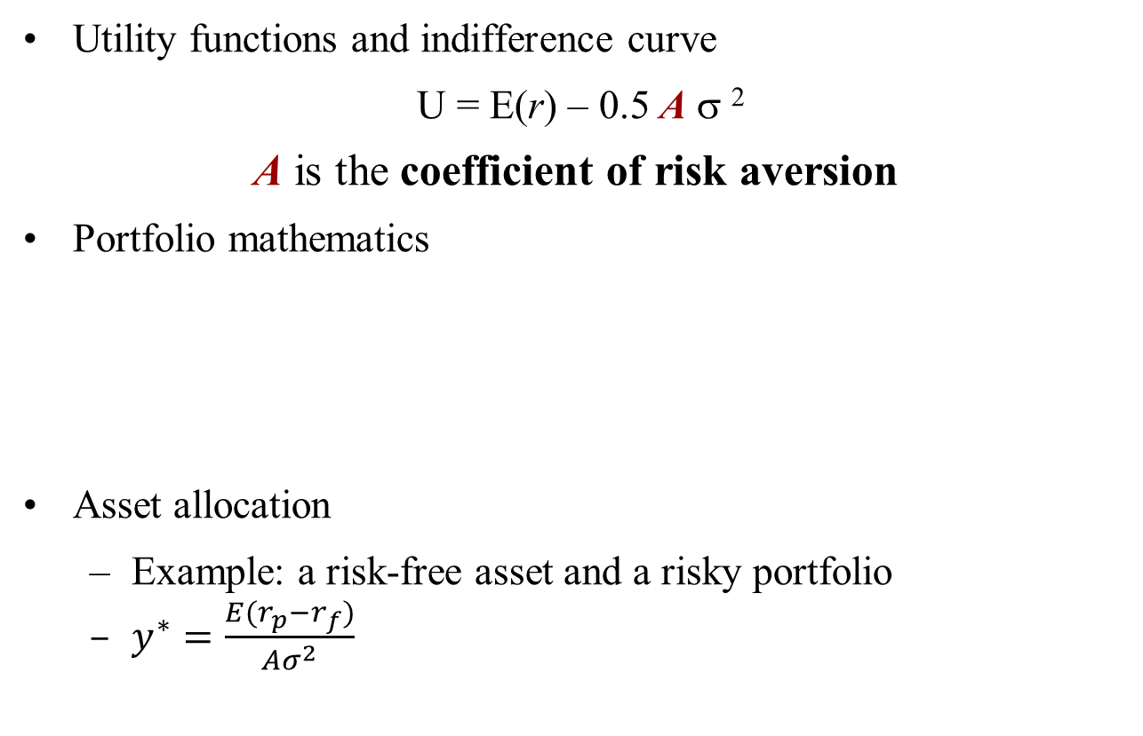
Review
Utility functions and indifference curve
U = E(r) – 0.5 A σ ²
A is the coefficient of risk aversion
Portfolio mathematics
Asset allocation
Example: a risk-free asset and a risky portfolio
$y^{∗}=\frac{E(r_{p}−r_{f})}{Aσ^{2}}$

Slide 2
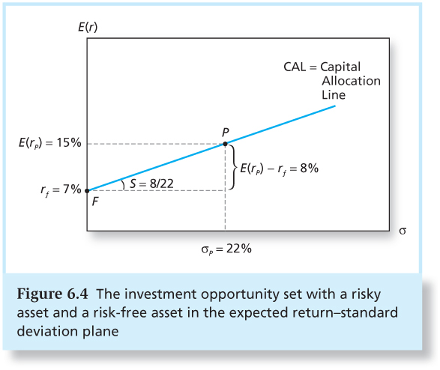
Capital Allocation Line

Slide 3
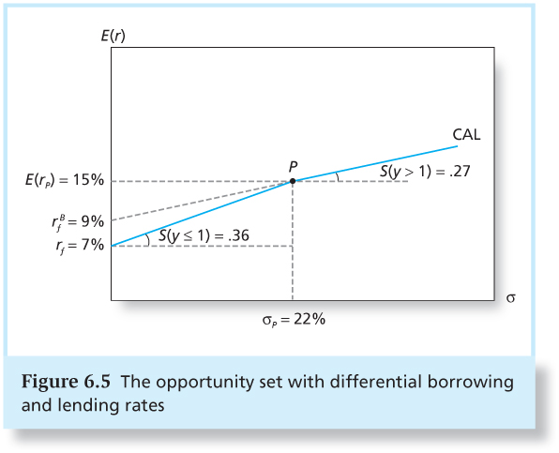
What If Lending and Borrowing Rates are Different?
Suppose the borrowing rate is 9% :

Slide 4
Optimal Asset Allocation
U(r) with A=4
E(r_{c})
U(r) with A=5
CAL
E(r_{p}) = 15%
P
E(r_{c}) = 13.64%
E(r_{c}) = 9.64%
r_{f} = 7%
0
σ_{c}
σ_{c}= 7.26%
(y = 0.33)
σ_{c} = 18.26%
(y = 0.41)
σ_{p} = 22%
(y=1)

Slide 5
Optimal Risky Portfolios

Slide 6
Objective
Construct optimal portfolios of two risky assets
Combine these two risky assets with the risk-free asset
Generalize these results to the case of multiple risky assets and one risk-free asset

Slide 7
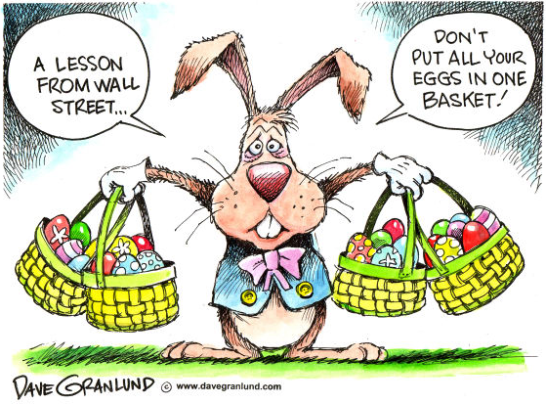
Portfolio Risk

Slide 8
Long history…
Mentioned in the book of Ecclesiastes, written in approximately 935 B.C.:
“But divide your investments among many places, for you do not know what risks might lie ahead”
Mentioned in Shakespeare’s The Merchant of Venice:
My ventures are not in one bottom trusted,
Nor to one place; nor is my whole estate
Upon the fortune of this present year:
Therefore, my merchandise makes me not sad.

Slide 9
Systematic vs. Unsystematic Risk
A portfolio can contain many assets, and it allows an investor to become diversified.
Most risky securities, such as stocks and bonds, have two components of risk:
General economic uncertainty
Business cycle, inflation rate, interest rate, exchange rate, etc.
Affect all firms in the economy, cannot be diversified away
Nondiversifiable risk, systematic risk, or market risk
Firm-specific uncertainty
Sales growth, R&D, relative performance, etc.
Peculiar to the firm, and can be eliminated by diversification in a portfolio
Diversifiable risk, unsystematic risk, or idiosyncratic risk

Slide 10
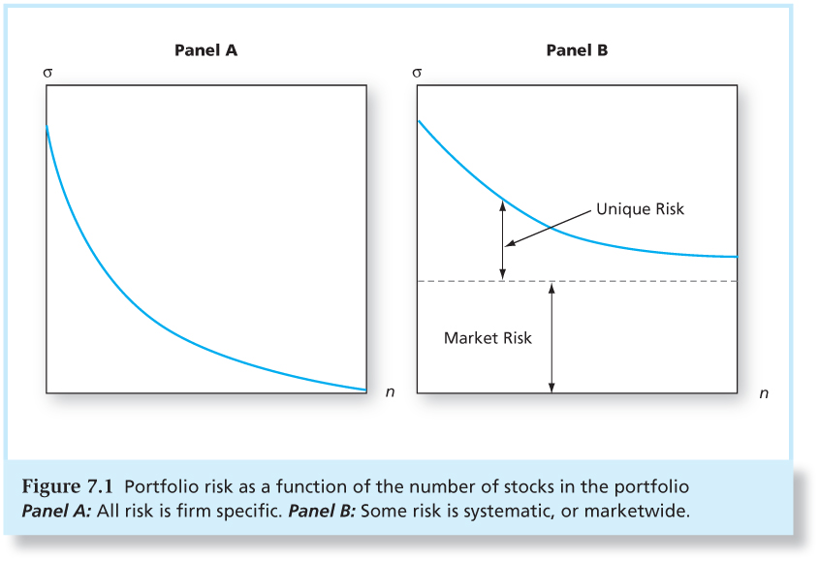
Portfolio Risk and Number of Securities
The figures show how the unsystematic risk declines as the number of securities held in a portfolio increases.

Slide 11
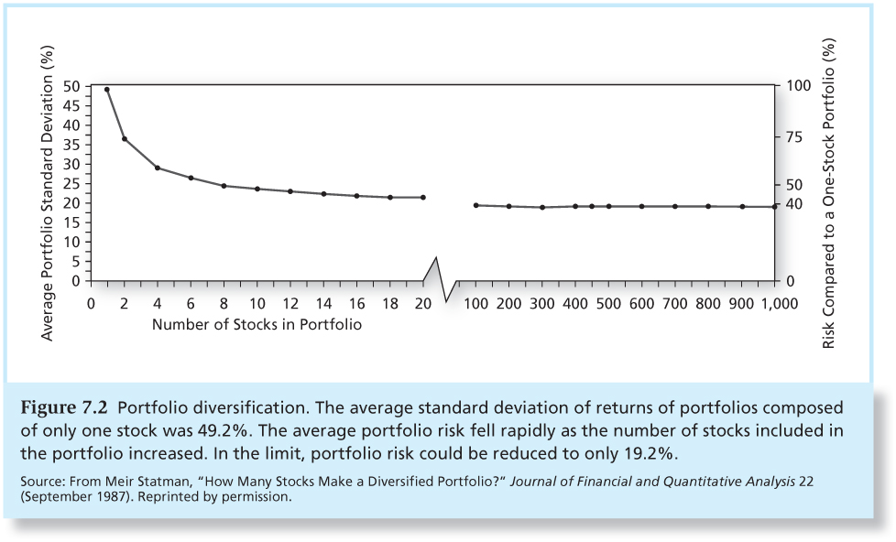
Portfolio Diversification
Defining a diversified portfolio:
Are all portfolios with lots of securities diversified?
Do other conditions need to be met to call a portfolio diversified?

Slide 12
Two-Risky-Asset Case
Recall from the rules of calculating the expected return and variance of a portfolio of two risky securities:
Here D and E are the two risky assets (denoting two portfolios of bonds and stocks). Recall also that:
where ρ_{DE} is a correlation coefficient. It takes a value between –1 and +1, depending on how often the two securities move together vs. opposite.

Slide 13
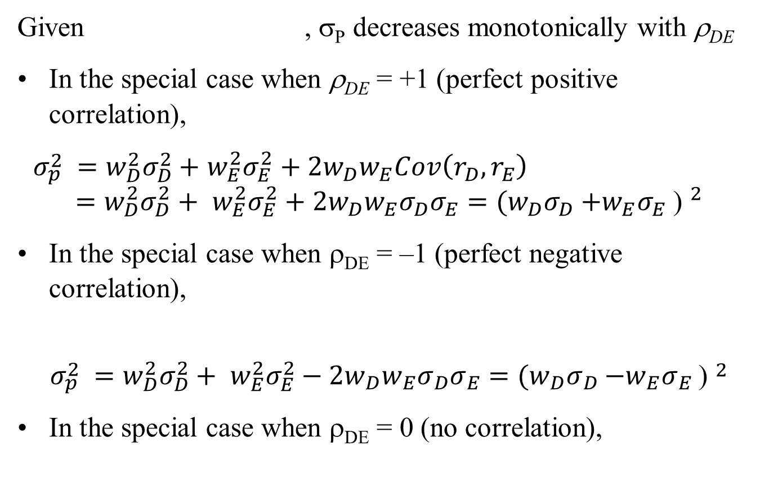
Role of Correlation ρ
Given , σ_{P} decreases monotonically with ρ_{DE}
In the special case when ρ_{DE} = +1 (perfect positive correlation),
$σ_{p }^{2}=w_{D}^{2}σ_{D}^{2}+$ $w_{E}^{2}σ_{E}^{2}+2w_{D}w_{E}Cov\left(r_{D},r_{E}\right)$
$$=w_{D}^{2}σ_{D}^{2}+ w_{E}^{2}σ_{E}^{2}+2w_{D}w_{E}σ_{D}σ_{E}={(w_{D}σ_{D}{+w_{E}σ}_{E}\text{) }}^{2}$$
In the special case when ρ_{DE} = –1 (perfect negative correlation),
$$σ_{p }^{2}=w_{D}^{2}σ_{D}^{2}+ w_{E}^{2}σ_{E}^{2}−2w_{D}w_{E}σ_{D}σ_{E}={(w_{D}σ_{D}{−w_{E}σ}_{E}\text{) }}^{2}$$
In the special case when ρ_{DE} = 0 (no correlation),

Slide 14
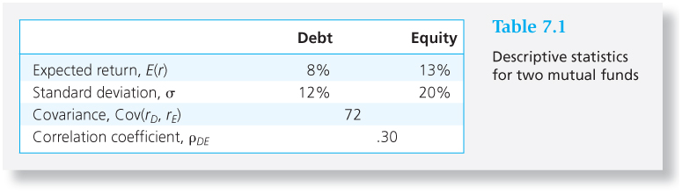
Two Risky Assets – An Example
Assume an investor chooses w_{D} = 0.3 and w_{E} = 0.7, what’s his
portfolio’s E(r_{p}) and σ_{P} ?

Slide 15
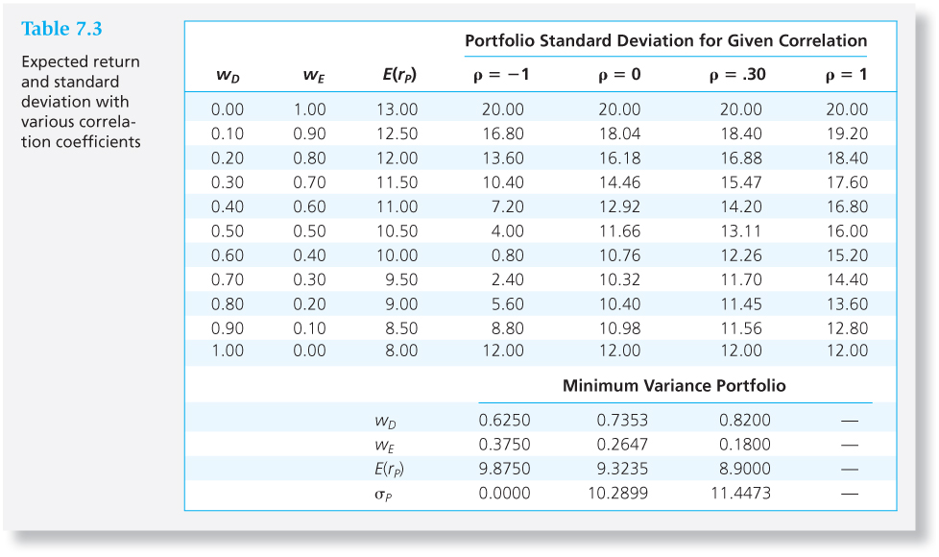
Two Risky Assets – An Example

Slide 16
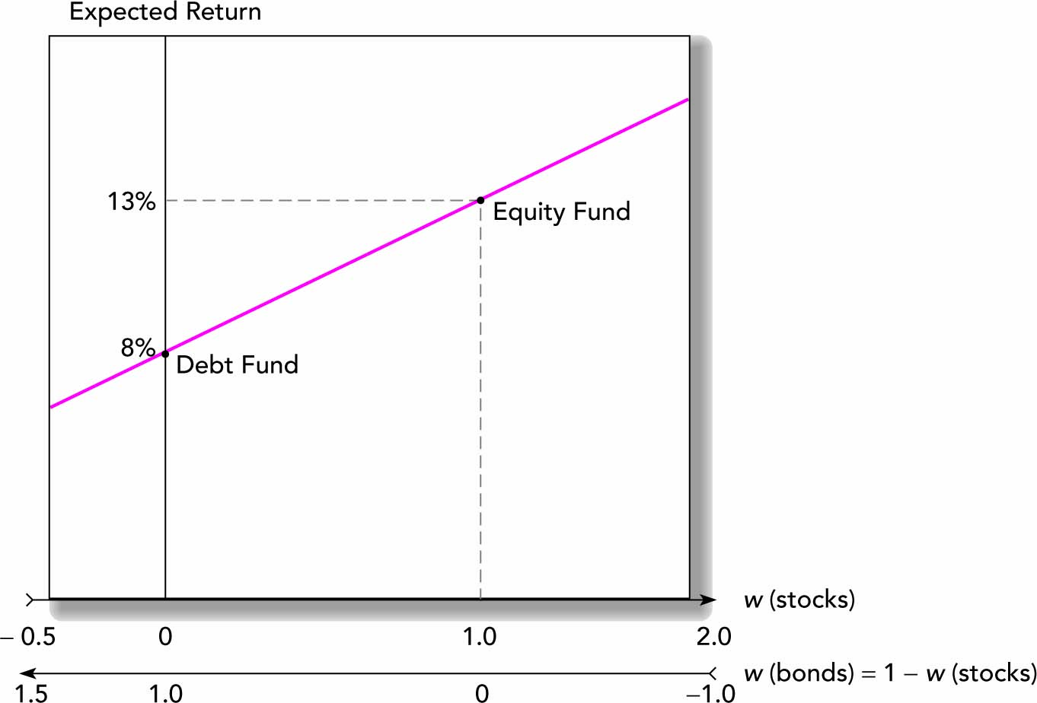
Portfolio Expected Return and Investment Weight

Slide 17
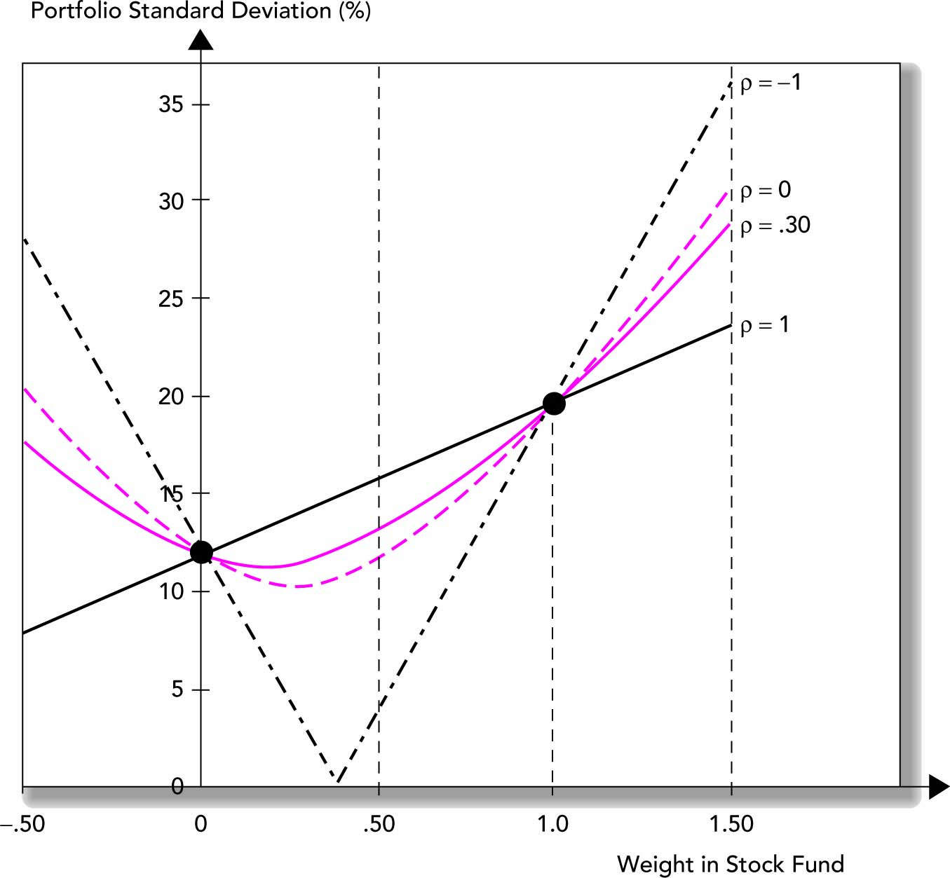
Portfolio Standard Deviation and Investment Weight

Slide 18
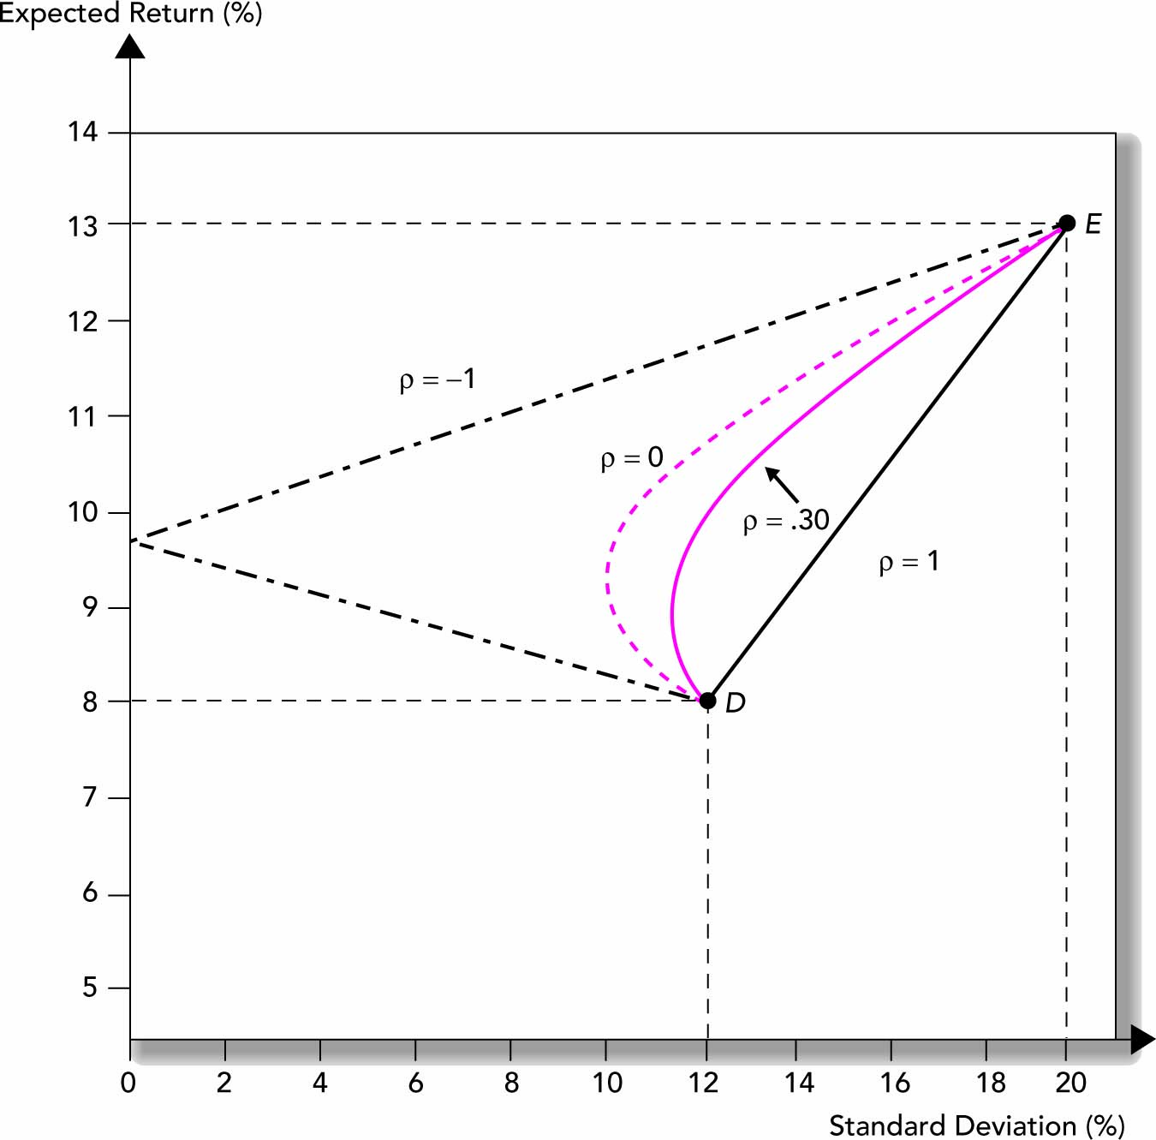
Portfolio Expected Return and Standard Deviation
portfolio opportunity set

Slide 19
Correlation Effects Continued
The relationship depends on correlation coefficient ρ (-1.0 < ρ < +1.0).
The smaller the correlation, the greater the risk reduction potential.
If ρ = +1.0, no risk reduction is possible.
Can we identify a portfolio with a minimum variance, so that we can see how much risk reduction will be by combining assets?

Slide 20
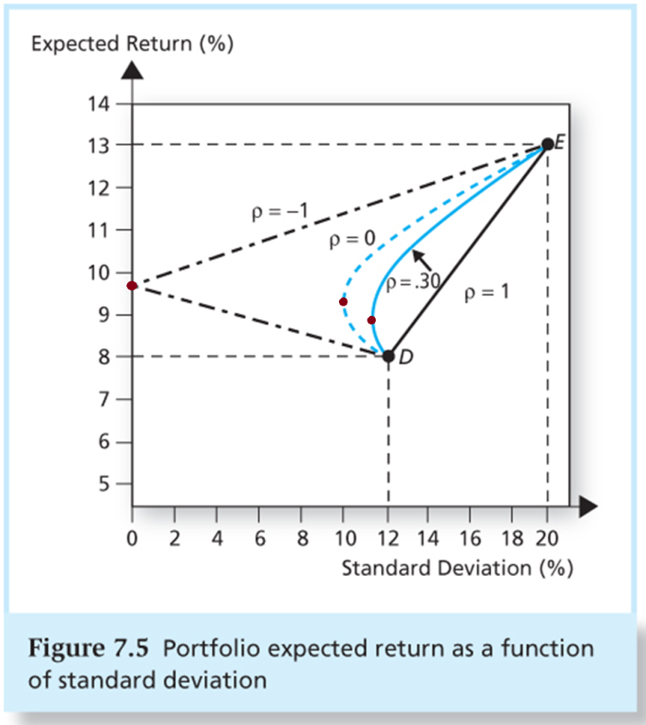
Some Portfolio Frontier Concepts
The portfolio frontier in Figure 7.5 has a nose. This nose is the minimum variance portfolio with the given data.
The portfolio frontier above the nose is called the efficient frontier, and below the nose is called the inefficient frontier. Why?
Can this portfolio extend to the south-east of D and north-east of E?

Slide 21
How to find the Minimum Variance Portfolio?
Assume any portfolio p, consisting of two risky assets:
The objective is to find w₁* and w₂* that gives the minimum variance
Min.
Subject to
Differentiating this with respect to w₁, and setting the derivative equal to zero gives the solution:

Slide 22
Optimal Risky Portfolio – Two Risky Assets
Assume the two risky assets D and E have ρ_{DE} = 0.3. The minimum-variance portfolio has E(r) =8.9%, and σ = 11.45%, according to Table 7.3.
E(r)
Indifference Curve
E(r_{c})
C
Tangency portfolio
E(r_{A}) = 8.9%
A (Minimum Variance Portfolio)
σ_{A} =11.45%
σ
σ_{c}

Slide 23
Optimal Risky Portfolio – Two Risky Assets
When there are only two risky assets, the optimal risky portfolio is determined by the portfolio opportunity set and the indifference curve.
Graphically, this is the point on the combination line where the slope of the indifference curve is equal to the slope of the portfolio opportunity set.

Slide 24
Extending to Include Riskless Asset – An Example
We introduce a risk-free asset: r_{f} = 5%
Using the method discussed in the last lecture, we draw a CAL using the risk-free asset and another risky asset.
CAL (P)
E(r)
CAL (A)
E(r_{P})
P
Tangency portfolio
B
E(r_{p})-r_{f}
E(r_{A}) = 8.9%
A (Minimum Variance Portfolio)
r_{f}=5%
σ_{A} =11.45%
σ_{P}
σ

Slide 25
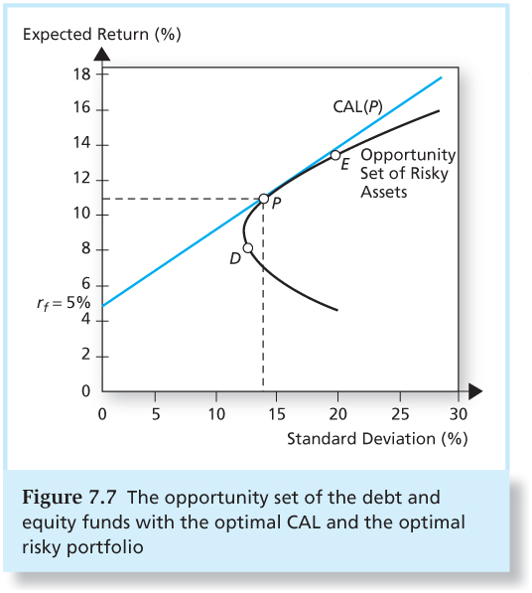
The Optimal CAL and the Optimal Risky Portfolio

Slide 26
How to find the Tangency Portfolio P?
Assume any portfolio p, consisting of two risky assets:
The objective is to find w₁* and w₂* that gives the highest slope (Sharpe ratio) of the CAL, i.e., the tangency portfolio
Max.
Subject to

Slide 27
How to find the Tangency Portfolio P?
Differentiating this with respect to w₁, and setting the derivative equal to zero gives the solution:

Slide 28
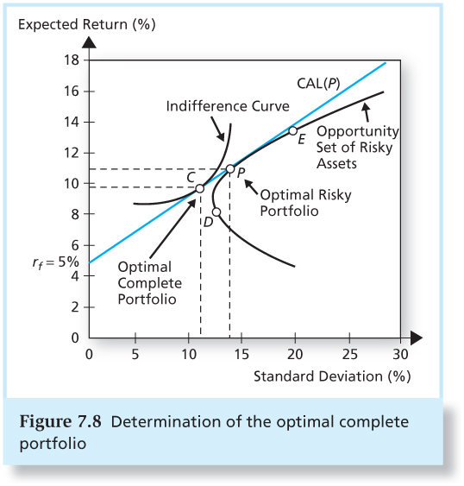
Optimal Complete Portfolio
The optimal complete portfolio is determined by the tangency of an indifference curve with the CAL from the optimal risky portfolio.

Slide 29
Example of the Optimal Complete Portfolio
Find the optimal complete portfolio for an investor with risk aversion A = 4. Given:
Bonds: E(r₁) = 8% σ₁ = 12% ρ_{1,2} = 0.30
Stocks: E(r₂) = 13% σ₂ = 20% σ_{1,2} = 0.0072 r_{f} = 5%
Note: Here we use decimal points to calculate standard deviation, so we have σ_{1,2} = 0.0072 . If we use percentage points, σ_{1,2} = 72. The results should be the same, but decimal points are preferred.

Slide 30
Example of the Optimal Complete Portfolio
[E(r₁) – r_{f}] σ₂² – [E(r₂) – r_{f}] σ_{1,2}
[E(r₁) – r_{f}] σ₂² + [E(r₂) – r_{f}] σ₁² – [E(r₁) – r_{f} + E(r₂) – r_{f}] σ_{1,2}
[0.08 – 0.05] 0.04 – [0.13 – 0.5] 0.0072
[0.08 – 0.05] 0.04 + [0.13 – 0.05] 0.0144 – [0.08 – 0.05 + 0.13 – 0.05] 0.0072
= 0.40,
1 – w₁ = 0.60
Tangency portfolio’s expected return, risk, and Sharpe ratio:
E(r_{P}) = 0.4×0.08 + 0.6×0.13 = 0.11 or 11%
σ_{P} = [0.4²×0.0144 + 0.6²×0.04 + 2×0.4×0.6×0.0072]^{1/2} = 0.142 or 14.2%
S_{P} = (0.011 – 0.05) / 0.142 = 0.42
w₁ =
=
w₂ =

Slide 31
Example of the Optimal Complete Portfolio
An investor with risk aversion A = 4 would hold a complete portfolio:
y* = [E(r_{P}) – r_{f} ] / A σ_{P}² = (0.11 – 0.05) / (4×0.142²) = 74.39 %
E(r_{c}) = 0.7439×0.11 + 0.2561×0.05 = 0.0946 or 9.46%
σ_{c} = 0.7439×0.142 = 0.1056 or 10.56%

Slide 32
What if there is a target return?

Slide 33
An Optimal Choice for an Investor
E(rc)
U(r) with A=4
CAL
Stocks
E(r_{P}) = 11%
P (Best mix of stocks
and bonds)
E(r_{c}) = 9.46%
Bonds
r_{f} = 5%
F
σ_{c}
0
σ_{c}= 10.56%
(y=0.7439)
σ_{P}=14.2%

Slide 34
Multiple Security Case
How do we generalize the results to the multiple risky security case? We first need to study the expected return and standard deviation of a portfolio of multiple risky securities. Let w_{i} denote the portfolio weight in risky security i. There are i=1,2,….,n risky securities. Then:
n
E(r_{P}) = ∑ w_{i} E(r_{i})
i=1
n n n n
σ_{P}² = ∑ ∑ w_{i} w_{j} Cov(r_{i} , r_{j}) = ∑ ∑ w_{i} w_{j} ρ_{ij} σ_{i} σ_{j}
i=1 j=1 i=1 j=1
The calculation of portfolio variance is best explained by a bordered covariance matrix.

Slide 35
Multiple Security Case
When n = 3, then

Slide 36
Extending Concepts to All Securities
The optimal combinations result in lowest level of risk for a given return → minimum-variance frontier
The optimal trade-off is described as the efficient frontier.
These portfolios are dominant.

Slide 37
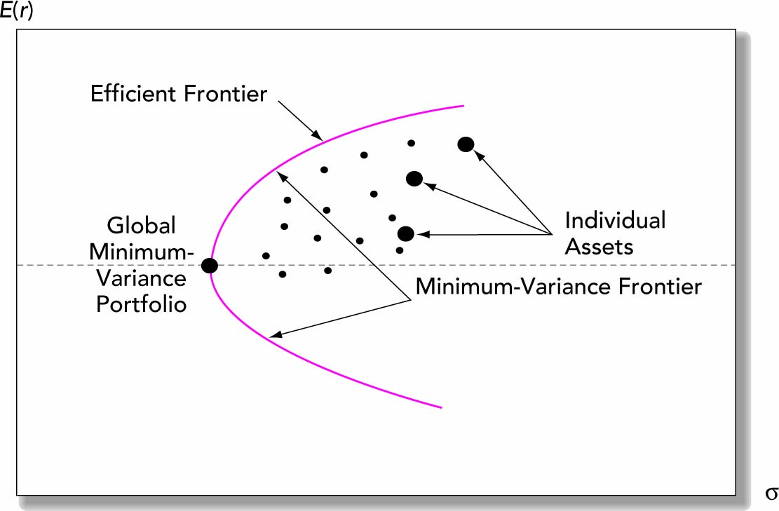
Security Selection – Minimum-Variance Frontier

Slide 38
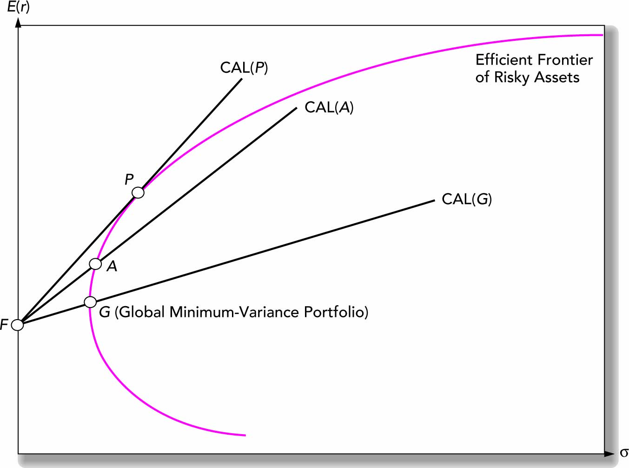
Capital Allocation Lines with Various Portfolios

Slide 39
Separation Property
A most interesting result is known as the Separation Property. Suppose an investment advisor has multiple clients with different levels of risk aversions. In absence of the risk-free security, the advisor will recommend different combinations of risky securities to different clients. But in presence of the risk-free security, he will recommend the same combination of risky securities to all clients. The CAL(P) thus becomes the separating line between the return dynamics and the risk aversion.

Slide 40
Optimal Portfolio – No Risk-free Asset
In absence of the risk-free security, the optimal portfolio will be different for investors with different risk preferences.
E(r)
Indifference Curve
C (Less risk-averse investor’s choice)
B (More risk-averse investor’s choice)
G (Global minimum variance portfolio)
σ

Slide 41
Two-fund Separation Theorem
E(r)
Indifference Curve
CAL
Y (Less risk-averse investor’s choice)
E(r_{P})
P (Tangency portfolio)
X (More risk-averse investor’s choice)
G (Global minimum variance portfolio)
r_{f}
σ_{P}
σ
w_{P} (risky asset)
<0
0
1.0
>1.0
1-w_{P} (riskfree asset)
>1.0
1.0
0
<0

